Slide 1
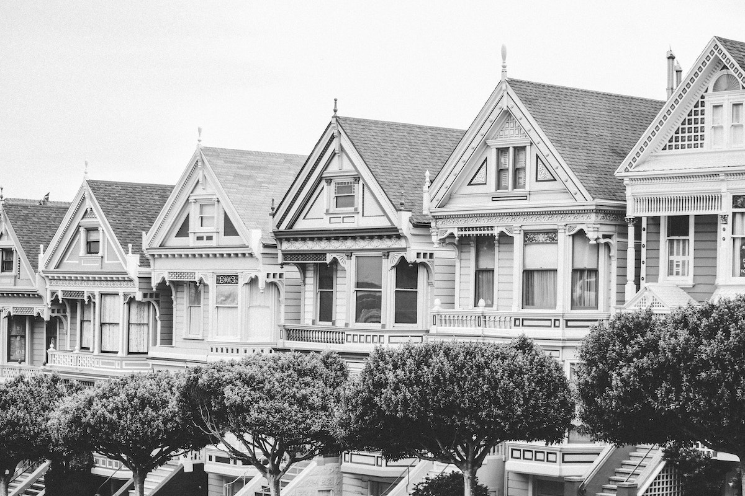
MACHINE LEARNING PROJECT
REAL ESTATE PRICE PREDICTION
SUBMITTED BY:
AADIKA BHATIA
00213203120
3RD YEAR
IT-1

Slide 2
INDEX
INTRODUCTION
PROJECT SUMMARY
TECHNOLOGY USED
TECH STACK
PLATFORM USED
HOW IT WORKS?
HEATWAVE
ACCURACY

Slide 3
INTRODUCTION
Buying a real estate a stressful thing .
Buyers are generally not aware of the factors that influence the prices of houses.
Real estate agents are the most trusted by the with the communication between the buyer and seller.
This model acts as a middle man and predict the actual cost of the houses.

Slide 4
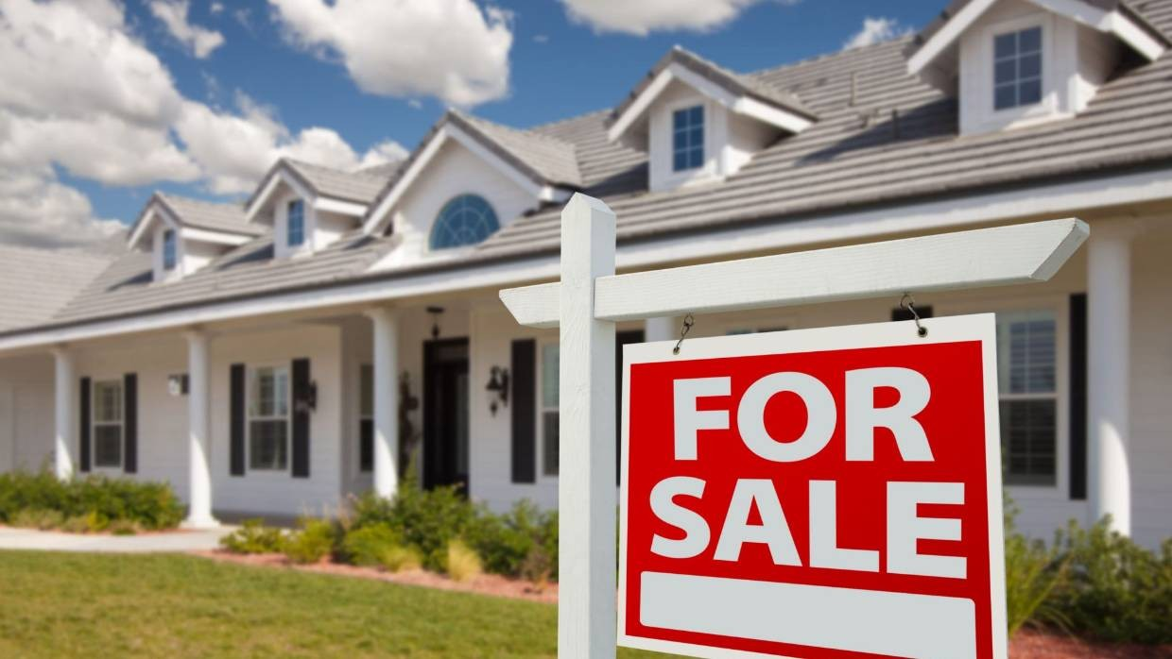
Customers believe property prices depend only on these factors:
Square foot area
Neighbourhood
No. of rooms
But it also depends on other factors:
Population status
Crime rate around the area
No. of storeys

Slide 5

PROJECT SUMMARY
This project was made under a bootcamp provided by Devtown. This bootcamp was focused on python, it’s different libraries and machine learning.
Here the dataset used was of Boston housing data for learning purpose only. This dataset comes pre loaded with the pandas dataframe.
Our training data consists of 506 examples of houses and 13 features.

Slide 6
TECHNOLOGY USED
MACHINE LEARNING
Tom Michelle explained : “A computer program is said to learn from experience E wrt some class of tasks T and performance measure as P,
if its performance with tasks T , as measured by P, increases with
experience E.
Example : playing checkers
E = experience of playing many games of checkers
T = the task of playing checkers
P = probability that the program will win the next game

Slide 7


EXAMPLE
Predict whether the given object is a dog or cat?
E = the experience of predicting many dogs and cats
T = the task of predicting dogs and cats
P = the probability that of whether it is a dog or a cat

Slide 8
In general machine learning problem can be broadly classified as :
Supervised Learning
It is the type of machine learning in which machines are trained using well "labelled" training data, and on basis of that data, machines predict the output. The labelled data means some input data is already tagged with the correct output.
Unsupervised Learning
It is a machine learning technique in which models are not supervised using training dataset. Instead, models itself find the hidden patterns and insights from the given data. It can be compared to learning which takes place in the human brain while learning new things.

Slide 9
TECH STACK
NUMPY
PANDAS
MATPLOTLIB
SKLEARN(SCIKIT LEARN)

Slide 10

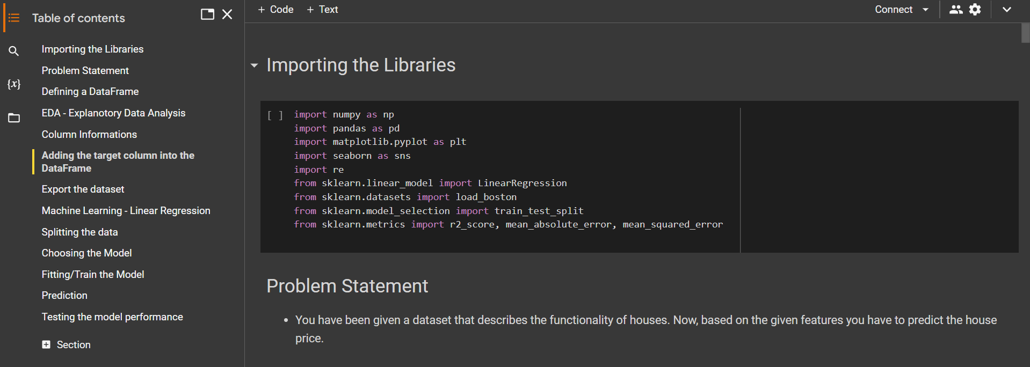
PLATFORM USED
GOOGLE COLAB

Slide 11
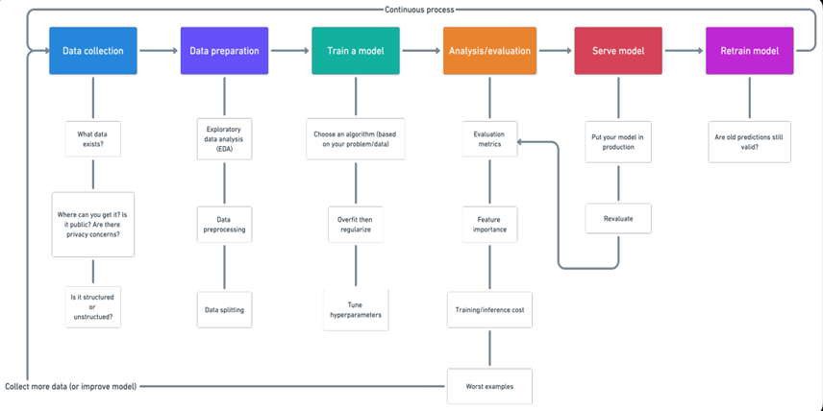
HOW IT WORKS ?

Slide 12
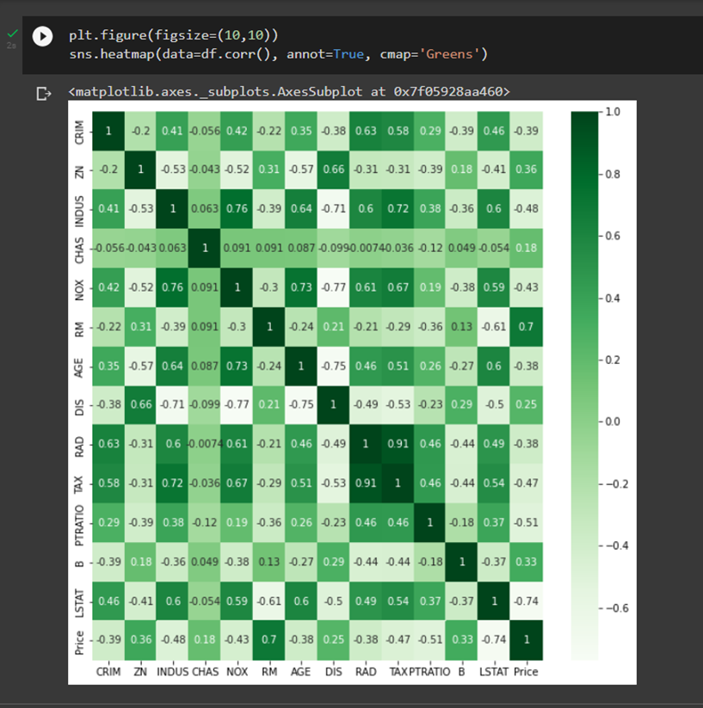
HEATWAVE

Slide 13
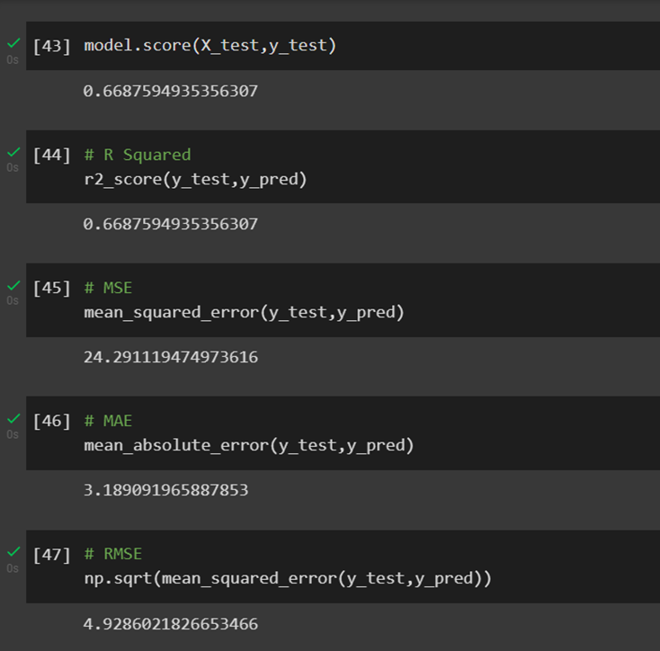
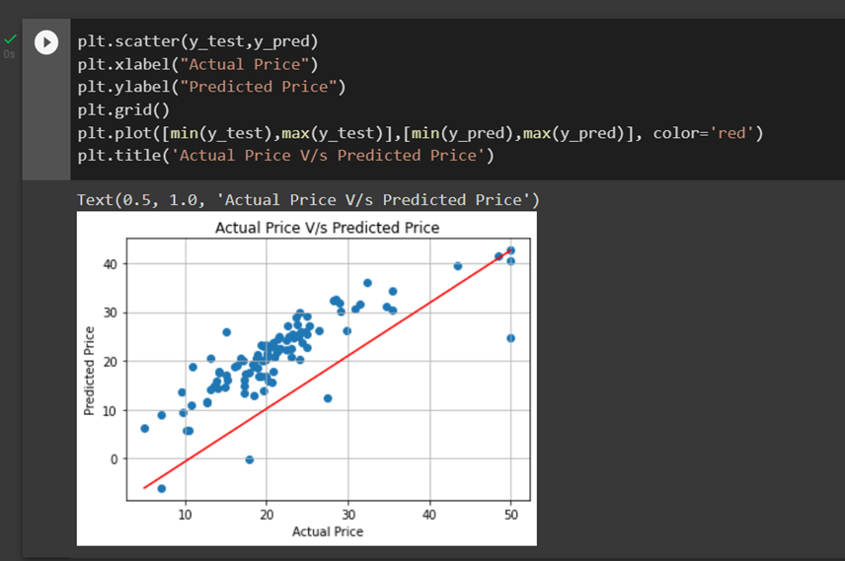
ACCURACY

Slide 14
THANK YOU

